Slide 1
GEOMETRIC DIMENSIONING & TOLERANCING
Source : info@tec-ease.com

Slide 2
G D & T
G D & T Tips
General
Datum
Selection
Actual Mating Envelope
Angularity
Basic Dimensions
Boundaries
Centerlines
Circularity
Coaxiality Controls
Composite Tolerancing
Concentricity
Cylindricity Inspection
Control of Datum Features
Datum Reference Frame
Datum Shift
Patterns of Features
Primary Datum Feature Control
Primary Datum Surface Control
Referencing Itself
Repetitive Patterns
Selection Based on Function
Selection - Sufficient in Size
Simultaneous Requirements
Symbol Placement
Position
Boundaries
Composite
Controlling Size and Form
Coplanarity
General
Increases Tolerance
Inspection
Location of Irregular Feature
Location of Planes
Profile vs Direct Tolerancing
Profile of a Line
Reporting Profile Inspection
Schedule of Tolerances
Surface Tolerance
Unequal and Unilateral
Basic Dimensions
Coaxial Control
Composite
General
Composite
Location of Irregular Feature
Material Condition Modifiers
Oblique Holes
Single Segment
Runout
Controlling Form
General
Inspection
Individual Control
Circular Runout
Circular vs Total
Runout vs Concentricity
Total Runout
Straightness
General
Unit Basis Symmetry/Position The GD&T Hierarchy Pyramid
Threads
MMC
Projected Tolerance Zone Wall Thickness

Slide 3
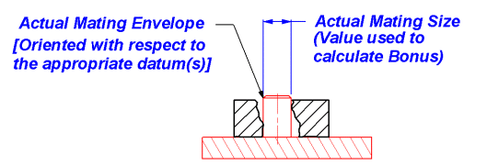
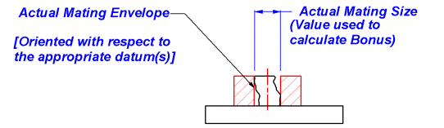

G D & T
Actual Mating Envelope
Calculating Additional Tolerance Permitted when a Position Tolerance is Modified at MMC.
An additional tolerance, often called Bonus tolerance, is permitted when a position tolerance is modified at maximum material condition
(MMC) and the actual mating envelope of the feature has departed from the MMC.
In these illustrations, the part is black and the actual mating envelope is red.
For an internal feature such as a hole or slot:
For an external feature such as a boss or tab:
If a hole, for instance, has the following size and geometric control, and the hole measures .502. It would be incorrect to use a bonus
tolerance of .003 (.502 - .499(MMC)) if the hole is not perfectly oriented to the Datums. If the hole is out of perpendicular to datum A
by .002, for instance, the bonus that may be used is reduced by that amount. The bonus would be merely .001 and the allowable
position tolerance = .016.

Slide 4
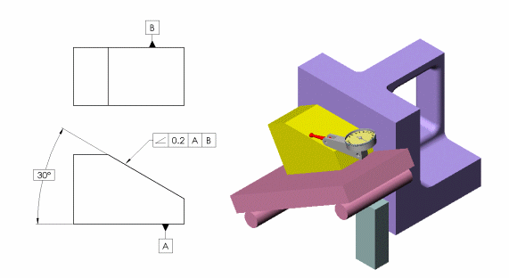
G D & T
Angularity
Use Two Datum References for Angularity!
When setting up a part for the measurement of angularity on a sine bar, it is difficult to orient the part before performing
the inspection.
This problem is overcome if a second datum is referenced in the angularity callout

Slide 5
G D & T

Slide 6
G D & T
Basic Dimensions
Give Production the Dimensions They Need.
When GD&T is used, the geometric tolerances apply to the features - not the dimensions. Therefore when BASIC
dimensions are used with geometric tolerances, several different dimensioning schemes may be used without changing the
meaning of the drawing. The first drawing below is an example of baseline dimensioning. The other two illustrate chain
dimensioning.
Since the position tolerance is related to datums A, B and C, all three drawings have the same meaning
even though the dimensioning is different. This would not be true if the dimensions locating the holes were
toleranced rather than BASIC. Because the meaning of these drawings is the same, the designer should consider the needs
of those who will read the print when placing dimensions

Slide 7
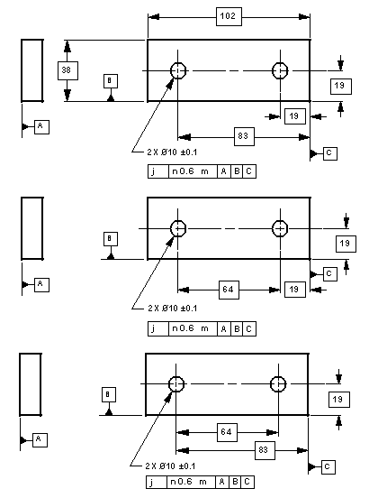
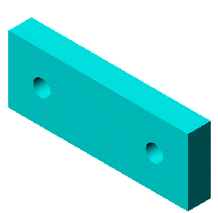
G D & T

Slide 8
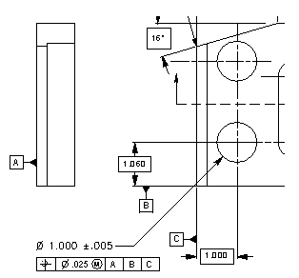
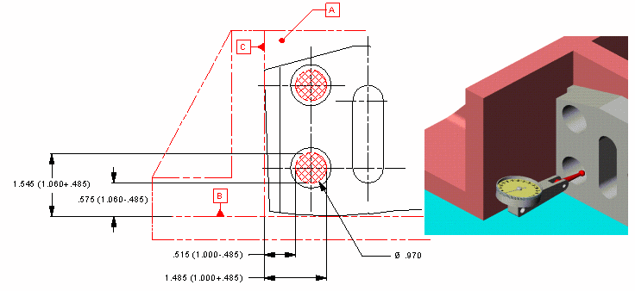
G D & T
Boundaries
Think Boundary, not Bonus
The typical approach to inspecting a feature such as
the n1.000 hole is to measure the size, calculate a bonus
and then try to locate the axis of the hole to see if it is within
the allowable position tolerance. Another approach is to inspect
the size and make measurements to see if the hole violates the
inner boundary (virtual condition). If a hard gage were produced
to inspect the position of this hole, it would have a pin n.970
(+gage tolerance and wear allowance) located at the basic location
from the datums.
This hard gage may be simulated using a height gage in an open
setup or CMM probe. By adding and subtracting half the virtual condition
from the basic dimensions, the distance from the datums that may not be
violated may be calculated. These distances may be easily inspected.

Slide 9
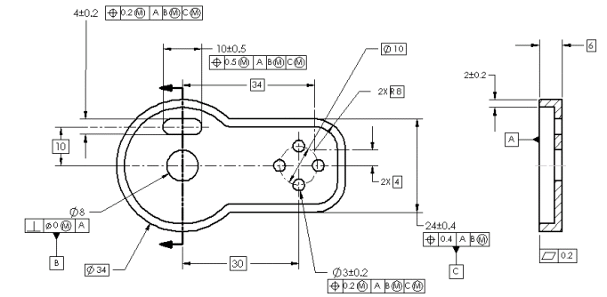
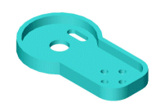
G D & T
Centerlines
Dimension to Centerlines When it Makes Sense
Many past Tips have illustrated dimensioning from and to center lines. There continues to be questions about when it is okay
to dimension with center lines and when it is not appropriate. Dimensions may be to and from center lines on a drawing if the
dimensions are basic and the center line is representing the:
axis, center point or centerplane of a feature of size
center of a pattern such as a bolt pattern
center of a radius
center of a slot length or width
In all of these cases if direct tolerancing is used, confusion may result. There is no reason to have this confusion except to
fall back on "that's the way we've always done it". If you always do what you've always done, you'll always get what you've
always got. In other words, you will never improve. The drawing below shows the common correct application of dimensions to
center lines. In every case the dimensions to and from the center lines are basic.

Slide 10
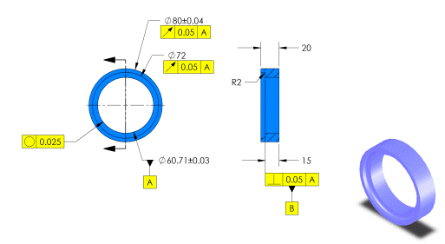
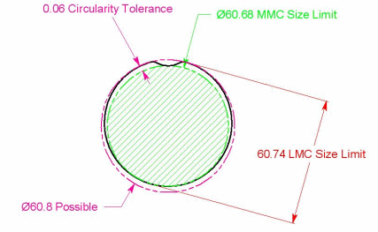
G D & T
Circularity
Size - Controlling Form
Yup, Circularity Error Can Be as Large as the Total Size Tolerance.
Here is a question that comes up from time to time. "How can the circularity error be as large as the total size tolerance since
circularity error is a radial tolerance?" The reason is that the LMC and MMC size limits of a feature of size are not coaxial
values. The total size tolerance on the inside diameter of 60.71 is 0.06mm. The figure at the bottom illustrates an extreme
case where the hole would just accept a 60.68 (MMC) full form check while at some cross sections the LMC size of 60.74
was not violated. Therefore, size is verified. The circularity error of this particular feature is 0.06, the total size tolerance, since
the circularity tolerance zone is comprised of two concentric circles. The size of the circles defining the circularity error could
be 60.68 and 60.8 as illustrated. If this isn't desireable, a circularity tolerance with a value less than 0.6 Could be added to
refine the circularity control provided by the limits of size. In this case, a 0.025 circularity tolerance was added.

Slide 11
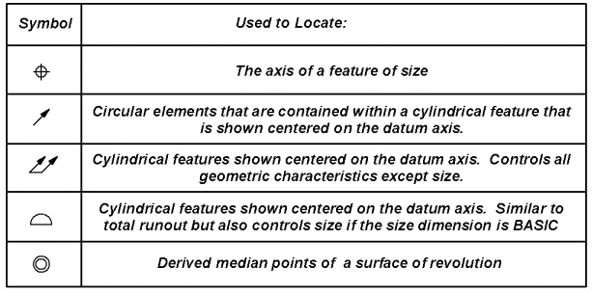
G D & T
Concentricity and Position - Coaxiality Controls
There are Five Ways to Control Coaxiality of Features. They are:
With so many options it is no wonder that many people find the differences hard to understand. Each control has its place,
although some are more difficult and time consuming than others. By comparing sample inspection methods, the differences may
become clearer. This month's tip will illustrate the differences between position and concentricity. Next month's tip will continue
with the runout tolerances and profile.
Position may use the MMC and LMC modifiers on the tolerance and Datum references. The illustration below shows a possible
gage (ignoring gage tolerance and wear allowance) that could be used when MMC is the modifier. If the sizes are within the size
tolerances but the part doesn't fit the gage, the features position (coaxiality) is out of spec. This type of control works well when
the main concern is the assembly of this part to another. The gage may usually be thought of as representing the worst
mating part

Slide 12
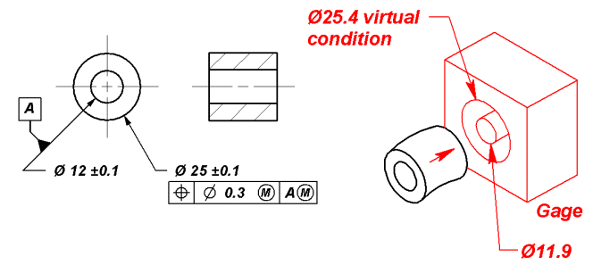
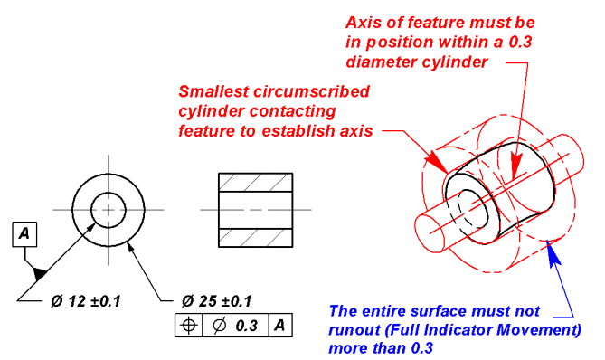
G D & T
According to the ASME Y14.5M-1994 Standard, when no modifiers are present, the implied condition is regardless of feature size as shown below.
In this case, the axis of the datum feature and the feature being controlled must be determined to find the error in coaxiality. Although this control
may be applied to bearings and dynamic balance applications, the job can usually be accomplished at a lower overall cost by using one of the
runout controls.

Slide 13
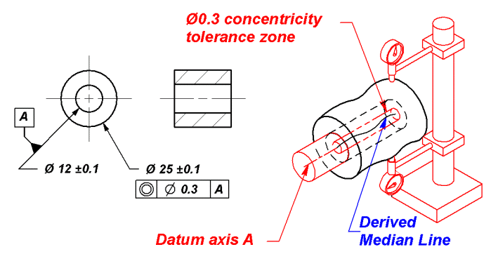
G D & T
the inspector derive a median line (see the June 1997 Tip-of-the-Month). In a situation where you don't care about the size, roundness or cylindricity
of the feature, concentricity may be specified. In thirty plus years of reviewing mechanical designs, I have never found a design where this is truly
the case. The closest application, perhaps, is when dynamic balance is needed. In such a case, measuring a part statically does not assure dynamic
balance if the material is not homogeneous. If dynamic balance is required, a dynamic balancing note is probably in order rather than concentricity.
For that reason, I often use the line, "When in Doubt, Use Runout."

Slide 14

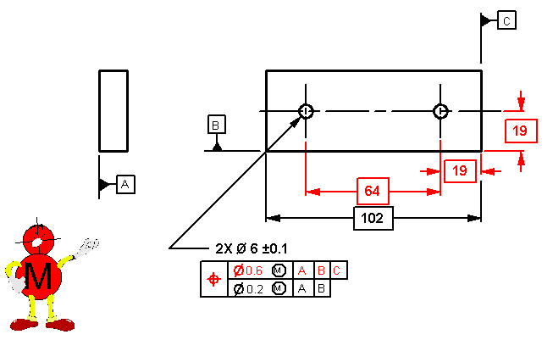
G D & T
Composite Tolerancing
When datum references are repeated in the second segment of a composite or single segment control, the meaning is different.
The tolerance in the upper segment of a composite tolerance is located by all applicable basic dimensions. On the drawing
above, the red tolerance is located by the red dimensions.
The lower segment of a composite tolerance does not use the basic dimensions which originate at the datums. Only the basic
dimensions within the pattern are applicable. If a datum is repeated, it indicates that the orientation of the pattern must be held
to the tighter tolerance. In this case, the perpendicularity to datum A must be within 0.2 and the pattern of two holes may not tilt
more than 0.2 relative to datum B.

Slide 15
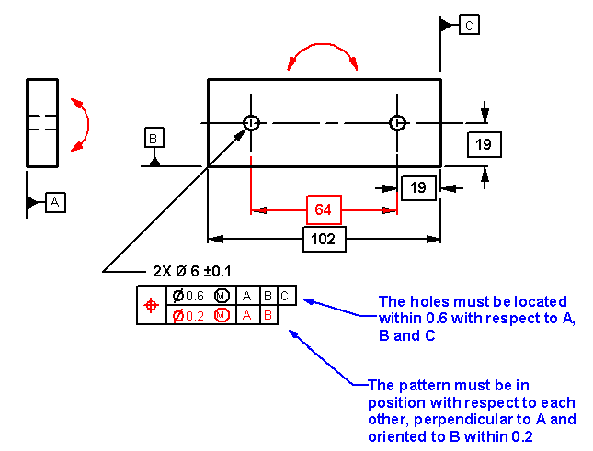
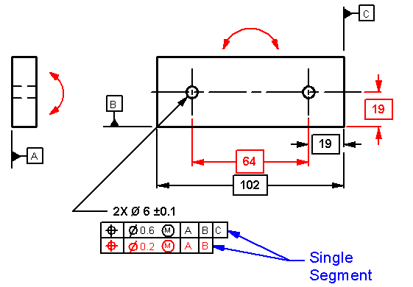
G D & T
You will now notice that there are two position symbols being used. This callout is not composite. It is called two single segments
. The upper segment has the same meaning as the upper segment of the composite callout shown earlier. The lower segment,
however, improves the location as well as the orientationof the feature(s) relative to the datums referenced in the second sement.
Notice that the 19mm dimension from datum B is shown in red. The pattern must be positioned at the 19mm dimension from
B within 0.2 total even though the pattern may be out of position as much as 0.6 total relative to datum

Slide 16
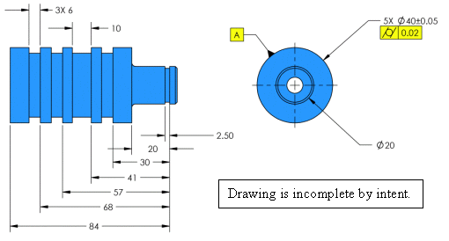
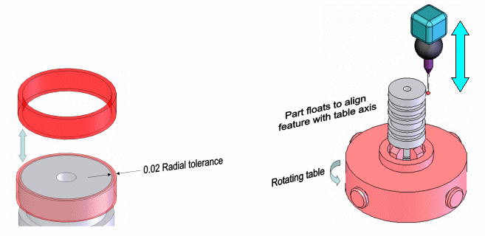
G D & T
Cylindricity Inspection
When Inspecting Cylindricity, There Is No Datum
Cylindricity is one of the more challenging tolerances to inspect. It requires isolating the feature from the rest of the part since
there can never be a datum referenced with cylindricity. In this example, the cylindricity has been applied to 5 features.
Cylindricity is an individual control. Therefore, each feature is inspected independent of the others. An electronic probe gathers
many points on the surface. A computer then evaluates the points to fit them between two concentric cylinders that may not
have a radial separation greater than 0.02. The actual size, location and orientation of the feature are ignored. Cylindricity is
a composite of circularity, surface straightness and taper.

Slide 17
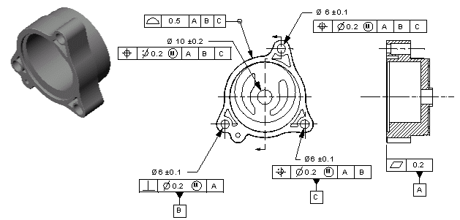
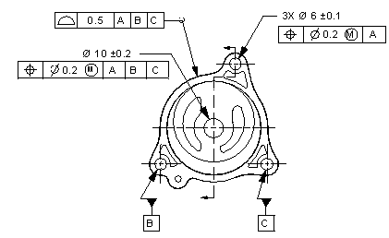

G D & T
Control of Datum Features
Keep Control of Datum Features Simple.
Frequently, designers use one or two features within a pattern as datum features. On the part shown, it is desirable to use two
of the holes in the three-hole pattern as datum features. One approach would be to apply individual controls to each of the holes
in the pattern as the first drawing illustrates. Another approach is to control the holes as a pattern using position relative to the
primary datum, A. Then, label individual holes as datum features as shown in the second plan view. Depending on the tolerances
and modifiers used, nearly the same control may be achieved with two less geometric controls, which simplifies the drawing and
may simplify verification while meeting functional requirements.

Slide 18
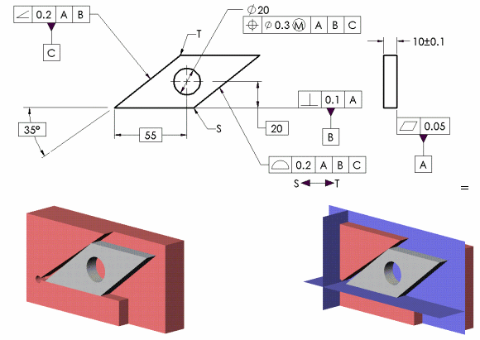
G D & T
Datum Reference Frame
Are Mutually Perpendicular - Even When the Datum Features Are Not.
It isn't always possible or practical to select datum features that are mutually perpendicular to one another when establishing a
datum reference frame. Notice that datum feature C is not nominally perpendicular to datum feature B. The datum feature
simulator for C would be made at 35° to the datum feature simulator for B (shown here in red). The actual datum planes
(shown in blue), which comprise the datum reference framework, would however be mutually perpendicular to one another as
is illustrated in the last figure. The deviation of the hole from the 55mm BASIC location would be measured from the third datum
plane-not from the sharp point on the actual part.

Slide 19
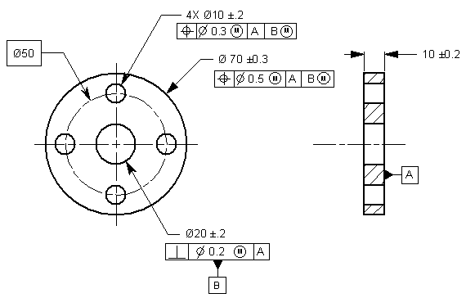
G D & T
Datum Shift
Datum Features can Give You a Shift - not a Bonus.
When datum features are modified at MMC or LMC, the datum feature and the features being controlled may be able to shift
relative to the datum axis or centerplane. On the drawing shown below, datum feature B, in the position callout of the four hole
pattern, is modified at MMC. This means the datum simulator for datum feature B would have a theoretical design size of 19.6.

Slide 20
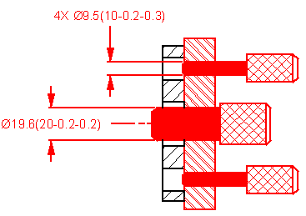
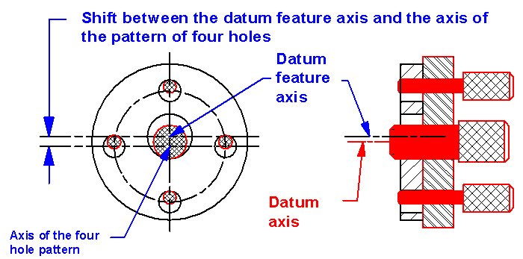
G D & T
Since the actual datum feature could be produced as large as 20.2, the
datum feature could shift as much as 0.6 total. This means the four-hole
pattern may shift out of position in one direction while the datum feature
shifts in the other direction as shown. A very common error made at
inspection is to use this allowed datum shift as a bonus on the features
being controlled. This would allow the features to be out of position to
each other more as the datum feature departs from MMC.
This practice does not agree with the drawing or a hard gage,
should one be produced

Slide 21
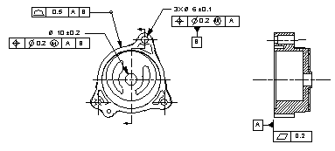
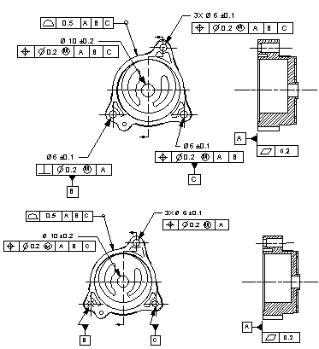
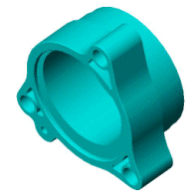

G D & T
Datum - Patterns of Features
Patterns of Features Used to Establish Datums Are Tricky
The Y14.5 standard tells us we can use a pattern of features to establish a datum or datums (section 4.5.8). Unfortunately, the
explanation that follows in the Standard only covers a pattern of holes at MMC. There is no support for using a pattern
of features of size RFS. Where two parallel holes are used as a pattern to help establish a datum reference frame, it is pretty
certain that two datum planes will result - one plane through the two holes and a second plane midway between the holes. Once
more than two holes are used as a pattern to establish a datum, the resulting datum reference frame is unclear. This month's
Tip is to avoid using a pattern of more than two holes to establish datums when referenced RFS.
On this drawing the pattern of three holes is identified as the datum
feature(s). There is no support for how to establish this datum
reference frame Regardless of Feature Size when inspecting the
profile and other position controls.
The next two drawings illustrate ways to use two of the holes to help
clearly establish a datum reference frame.

Slide 22
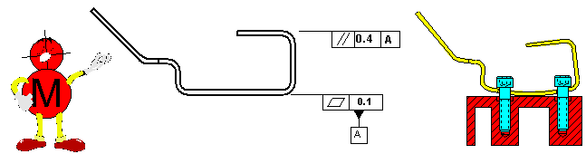
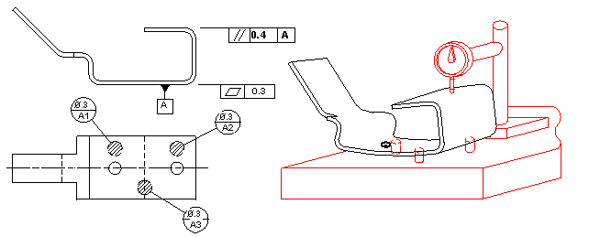
G D & T
Primary Datum Surface Control
Another Flatness Tip
When a flat surface is used as a primary datum, three considerations should be made to assure reproducible measurement
and a functional part.
1. Consider a flatness control on the datum feature. The primary datum is often a mounting surface that may be clamped
during assembly. Clamping may cause strain in the part. Strain causes stress and other critical features to vary in position or
orientation. The flatter the datum feature, the less distortion of the part.
INSPECT THE PART WITH DATUM FEATURE A
MOUNTED AGAINST A FLAT SURFACE USING
2-M6X1 BOLTS TORQUED TO 9-15 N-m
2. If the part is prone to distort and a tight flatness control is impractical, consider a constraint note. A constraint note is usually
intended to describe the condition of the part after assembly.
3. If a tight flatness control or constraint note does not fit your situation, datum targets should probably be specified. Since three points determine a plane, three targets should be used on a primary datum feature that is establishing a plane. If four or more targets are used, it is advisable to also include a constraint note.

Slide 23
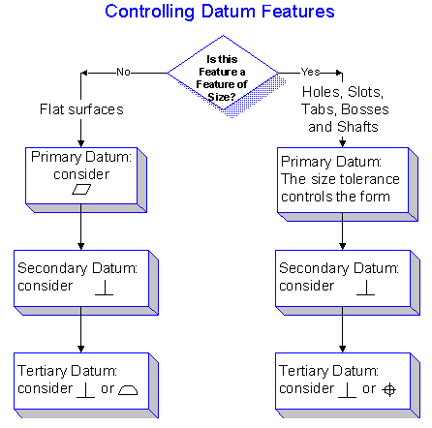
G D & T
Primary Datum Surface Control
Tie Your Datum Features Together - But Not Too Much!
pointed out the importance of applying flatness to a primary datum feature that is a plane surface if datum targets or a constraint
note are not used. The secondary and tertiary datum features should be related back to the primary. There is a difference
between a datum, that is theoretical, and a datum feature, that is an actual feature on a part. These datum features should be
geometrically controlled. Although the Y14.5 standard in section 4.3.3 the Standard states "Consideration shall be given to
controlling the desired accuracy of the datum features by applying appropriate geometric tolerances. ", nearly all of the figures
omit these geometric tolerances. For most parts the following flow chart may be used.
Although this flowchart won't work all of the time, it does
work on most parts. On parts such as sheet metal where
a secondary datum feature is usually very short the part
will probably always meet the control but because it is so
short, it will be nearly impossible to collect data to prove
that the process is capable. Also, depending on the shape
of the part, the tertiary datum feature may require a location
control (position or profile) relative to the primary and
secondary datums rather than perpendicularity.
Although this flowchart won't work all of the time, it does work on most parts. An exception might be on parts where the dimension
of the secondary datum feature that is perpendicular to the primary datum is small. It may be impractical to collect data to prove
that the process is capable of holding the perpendicularity (see figure). In such cases the process capability for perpendicularity
is usually sufficient. A perpendicularity control is probably not necessary and would only cause unnecessary inspection time.

Slide 24
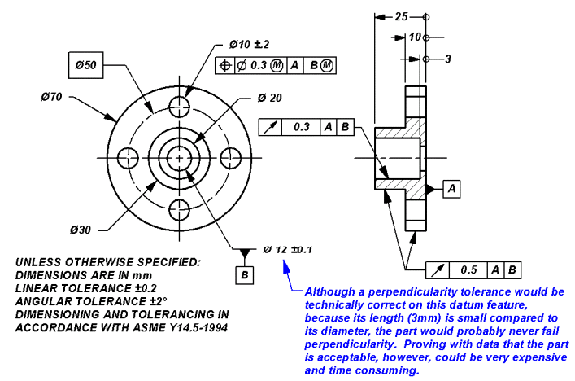
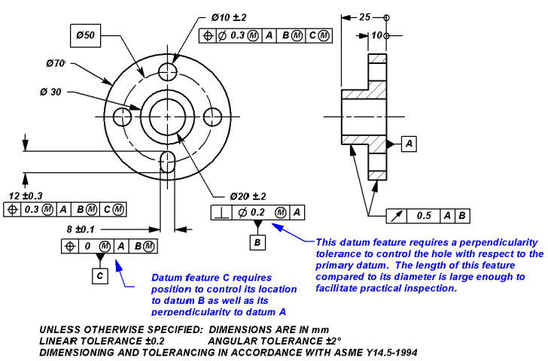
G D & T
Although this flowchart won't work all of the time, it does work on most parts. An exception might be on parts where the dimension
of the secondary datum feature that is perpendicular to the primary datum is small. It may be impractical to collect data to prove
that the process is capable of holding the perpendicularity (see figure). In such cases the process capability for perpendicularity
is usually sufficient. A perpendicularity control is probably not necessary and would only cause unnecessary inspection time.
Depending on the shape of the part, the tertiary datum feature may require a location control (position or profile) relative to the
primary and secondary datums, rather than perpendicularity. Ask yourself if you need to know where this feature is relative to
the primary and secondary datum features.

Slide 25
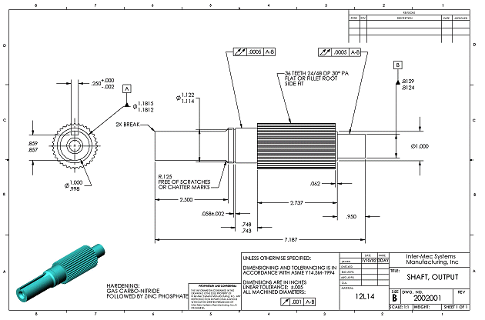
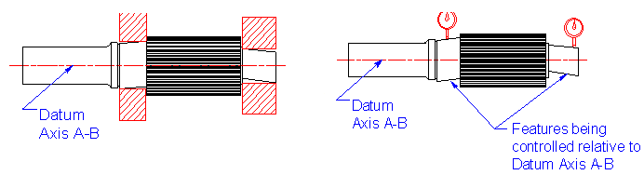
G D & T
Datum - Referencing Itself
It Is Referencing the Datum - Not Itself
I often get the question, "How can a feature reference itself in a feature control frame?" The answer is, "It can't." Datum features
referenced in a feature control frame are establishing a datum reference framework which serves as the origin of measurement.
The shaft shown has two total runout controls that appear to be referencing themselves. The total runout tolerance applies to the
surface of the features. The datum is an axis which is established using the two datum features A and

Slide 26
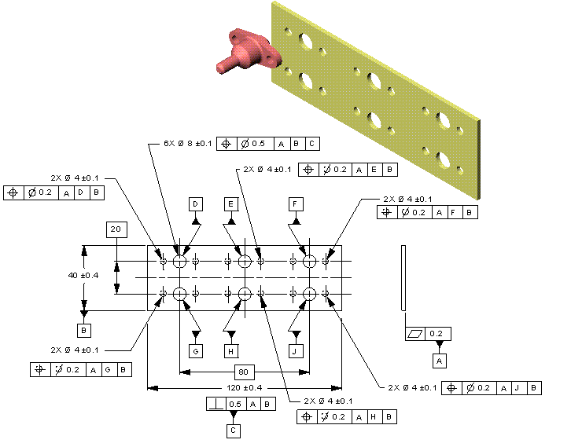
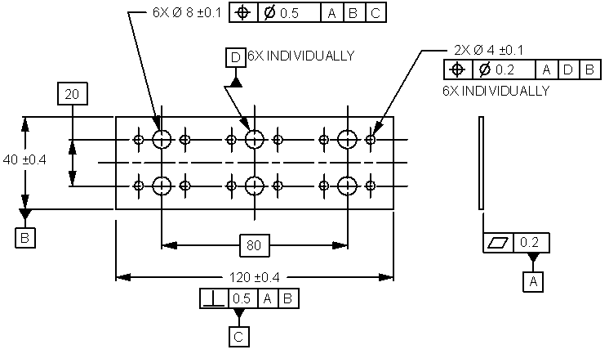
G D & T
Datum - Repetitive Patterns
Keep Identification of Datum Features Simple.
Frequently parts have repetitive patterns of features. Often it is desirable to use one of the features as a datum feature and control
the other features in the pattern relative to that datum. On the part shown the 6X Ø8 holes are located from datums A, B and C. A
very cumbersome way to locate the 2X Ø4 patterns of holes relative to the Ø8 holes individually, would be to assign a different
letter to each of the Ø8 holes exhausting six letters of the alphabet. This awkward method is shown in the first drawing. A more
efficient approach is illustrated on the second drawing. The Ø8 holes are identified as datum feature D INDIVIDUALLY. Each pair
of Ø4 holes has a position callout relative to A, D, B where D is the large hole nearest each pair. There are actually 6 datum D
features. By using the INDIVIDUALLY note, the drawing is greatly simplified

Slide 27
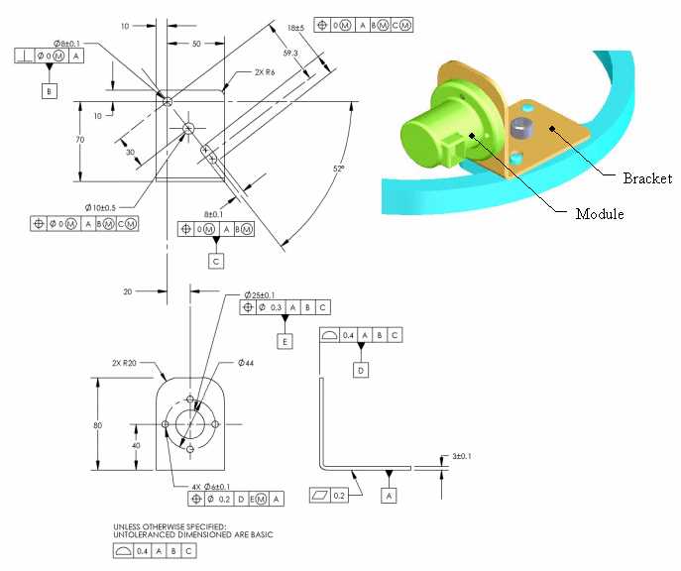
G D & T
Datum Selection - Based on Function
Select Your Datums Based Upon Function - Not Production
Often production complains about the datum features selected. In general, datum features should be selected based on function
-not on how the part will be produced. Two datum reference frames are used on the part shown below. The datum reference
frame established by datum features A, B and C was selected because these are the features that locate and orient the bracket.
From this datum reference frame the features used to locate and orient the module are located. The auxiliary datum reference
frame D, E, A could then be established to position the four mounting holes. This approach to selecting datum features is
functional and will usually result in the least variation in the assembly at the lowest cost. It is then up to production to use their
skill, knowledge and expertise to produce an in-spec part. Besides, most Production folks will tell you they really don't want the
Design folks telling them how to make parts.

Slide 28
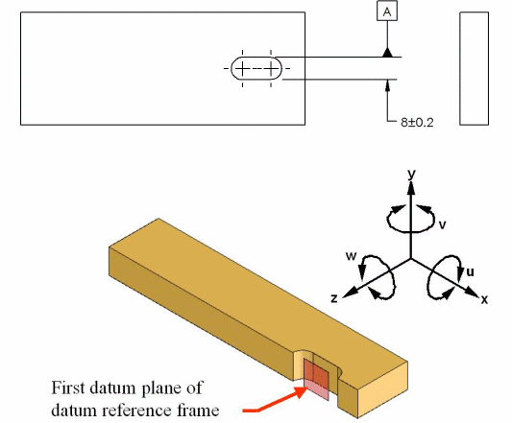
G D & T
Datum Selection - Sufficient in Size
You can Use a Slot as a Primary Datum Feature-If it is Large Enough
A recent question I received asked how to identify a slot width as a primary datum feature. I drew the illustration below to indicate
the proper method. Keep in mind that a slot may be thought of as containing two features of size-a length and a width. Rarely
though is a slot large enough to serve as a "good" primary datum feature. We use datum features to establish a datum reference
frame for the purpose of immobilizing the part. All parts in space have six degrees of freedom (DOF): 3 translations and 3 rotations.
These DOF are described and labeled in the Y14.5.1 standard and are illustrated in the lower figure. Datum precedence requires
that each datum feature in turn arrest or take away all of the DOF it is capable of. When used as a primary datum feature, a plane
arrests 3 DOF, a cylinder 4 DOF, a cone 5 DOF and a complex mathematically defined surface could arrest all 6 DOF. In this
example the datum is the center plane of the slot width. As a plane, it has to arrest 3 DOF: u, v and z. Given the size of the slot
relative the the size of the part, I would question if the designer really feels the slot is "sufficient in size to permit its intended use
" as a primary datum feature. That is why on most parts I review, slots are used as the secondary ot tertiary datum feature.

Slide 29
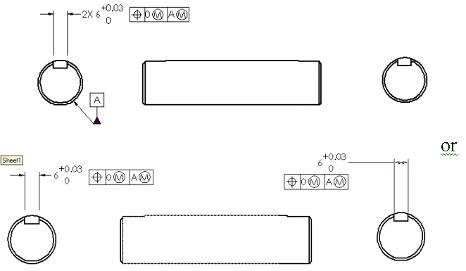
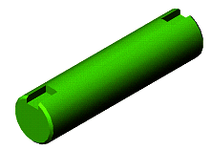
G D & T
Pattern - Simultaneous Requirements
If You Don't Want a Pattern, You Have to Say So!
Because of the simultaneous requirements rule stated in section 4.5.12 in the Y14.5 Standard, if features are controlled relative
to the same datum reference frame, the features are considered to be a pattern. Both drawings shown below indicate that the
two keyseats are a pattern and must be located as shown.
The keyseats are considered to be a pattern. Their orientation
is controlled by the position callout(s)
In order to unlock the orientation of the two keyseats to one another,
a note indicating separate requirements must be stated.

Slide 30
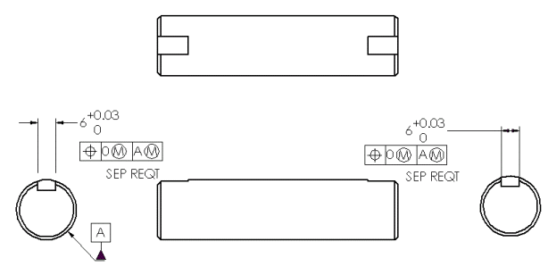
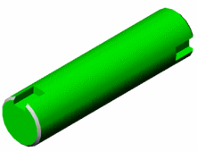
G D & T
In this example, the orientation of the keyseats is unimportant

Slide 31
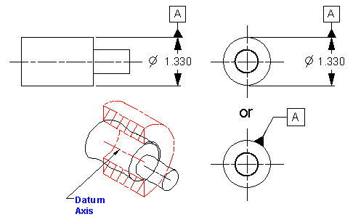
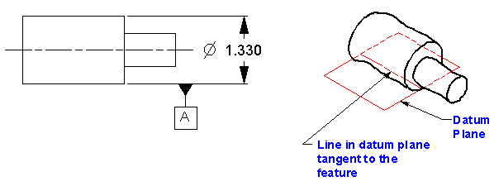
G D & T
Datum - Symbol Placement
Watch Where You Put That Triangle!
Placement of the new datum feature symbol (triangle) can be critical. In the first three views below the datum feature symbol
is associated with the size dimension of a feature of size. They indicate that a datum axis should be established using the
feature indicated.
In the view below, the datum may be interpreted as a line lying in a plane tangent to the feature indicated. If line contact is desired a datum target line should be indicated.

Slide 32
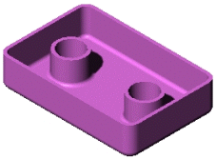
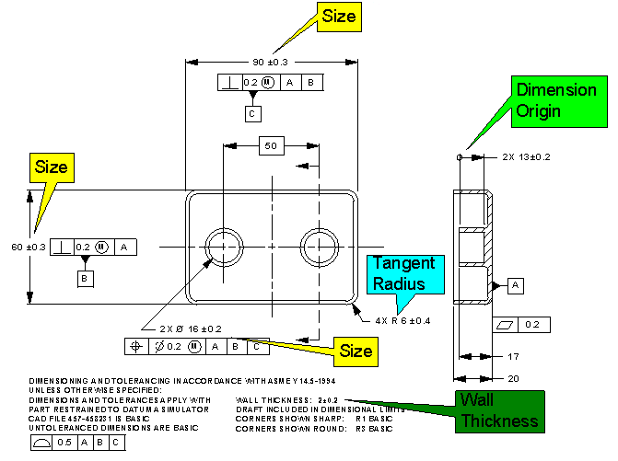
G D & T
Directly Toleranced Dimensions
Profile - Inspection
Toleranced Dimensions Still Have Their place.
Even though basic dimensions are being used today far more than in the past, there are still many appropriate applications for
toleranced dimensions. Care should be taken to only use toleranced dimensions in situations where they may be verified,
reproducibly, without the possibility of misunderstanding. This generally limits their use to:
Tangent radii
Some steps or depths
Wall and material thickness
Features of size that contain opposed points
Use of the dimension origin symbol clarifies the meaning
of the toleranced dimension.

Slide 33
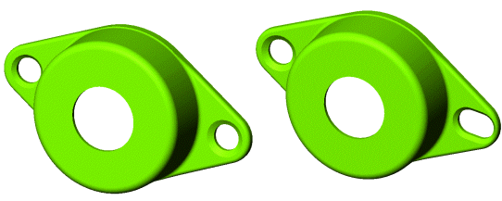
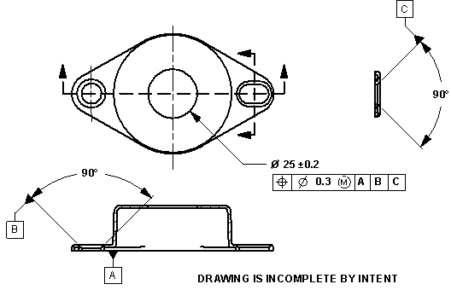
G D & T
Exact Constraint
Avoid Over Constraint in Your Designs.
Often designers use self-aligning features in assemblies. For the cover shown below on the left, two countersunk holes are being
used for location. Placing the part on datum feature A will arrest 3 of the part's 6 degrees of freedom. Tightening a flathead
screw through one of the countersunk holes will arrest two more degrees of freedom. Tightening a second flathead screw would
cause over constraint and very often this second screwhead will not seat properly. To avoid this situation, a countersunk slot may
be used in place of the second hole as is shown in the figure on the right. The countersink around the hole may then be used as
a secondary datum feature. The countersink on the width of the slot may serve as the tertiary datum feature to provide exact
constraint during inspection and in the assembly.

Slide 34


G D & T
Position - Feature of Size
If You Use Position, Make Sure You Have a Feature of Size
Position is used to locate features of size. A feature of size must contain opposed points. The radius in the first drawing may o
may not contain opposed points depending on the actual part variation. Position would be a misguided approach to controlling
the location of this feature. Making the dimensions basic and using profile of a surface is a better approach.
In the second example the feature would always contain opposed points. This feature may be located using profile of a surface
or position as shown.

Slide 35
G D & T
Fixed and Floating Fasteners
The Fixed and Floating Fastener Formulas are Not Just for Fasteners.
Nearly all assemblies fall into the categories of either fixed or floating features. A floating feature assembly might be a shaft
floating within two bushings. Where a part floats between multiple features, the floating fastener formula will usually apply.
The ASME Y14.5M-1994 standard gives the floating fastener formula as H = F + T where:
H is the clearance hole's maximum material condition (smallest limit of size)
F is the fastener's maximum material condition (largest limit of size)
T is the positional tolerance
For floating type assemblies, just substitute the internal feature's smallest size (MMC) for H, the external feature's largest size
(MMC) for F and the allowable positional tolerance (T) may be calculated.
When a screw or dowel pin is assembled, it becomes "fixed" to the mating part. Therefore, the fixed fastener formulas work
whenever features are "fixed" on mating parts. These assemblies include bosses fitting into holes, tabs fitting into slots, etc.
The ASME Y14.5M-1994 standard gives the floating fastener formula as H = F + T1 + T2 where:
H is the clearance hole's maximum material condition (smallest limit of size)
F is the fastener's maximum material condition (largest limit of size)
T1 and T2 are the positional tolerances for the holes and fasteners.
For fixed type assemblies, just substitute the internal feature's smallest size (MMC) for H, the external feature's largest size
(MMC) for F and the allowable positional tolerance (T1 + T2) may be calculated. T1 and T2 need not be equal and may be
distributed to reflect process capability of the processes being used. For the assembly shown below:

Slide 36


G D & T
The two tabs fitting into the two slots is a fixed fastener assembly. MMC of the two tabs is 10.1. MMC of the two slots is also 10.1.
Therefore H = F + T1 + T2 or 10.1 = 10.1 + 0 + 0.

Slide 37

G D & T
Flatness
Straightness
Consider Straightness on Your Parts Made from Flat Stock.
Many parts are made from stock which is left in the as furnished condition. Rule #1 does not apply to the thickness of these parts.
Therefore, the form variation of the part is whatever the mill supplies. Many designers will control the form of such parts with
flatness. Flatness is often a very time consuming inspection. When straightness at MMC is applied to the material thickness,
a simple envelope gage at the virtual condition may be used to limit form variation. In this example, the envelope gage used to
verify straightness would measure 1.025. The actual local size of this part must be checked with a micrometer type measurement
to assure that, at any cross section, the thickness is between .995 and 1.005.

Slide 38

G D & T
Free State
Use the new free state symbol for your plastic, sheet metal and other flexible parts. In section 1.4 FUNDAMENTAL RULES of
Y14.5, paragraph (l) tells us that "All dimensions and tolerances apply in a free state condition. This principle does not apply to
nonrigid parts as defined in paras. 2.7.1.3(b) and 6.8." The default, then, is that all parts are considered rigid unless there is
some indication that the part may be flexed or distorted for inspection. A way to indicate that a part is not rigid is to add a
constraint note. If some tolerances are to be checked with the part not constrained, the new free state symbol may be added to
specific tolerances. Many useable sheet metal and plastic parts will pass inspection and be functional if clamped to a condition
that simulates the assembled or functional state. Usually when a constraint note is applied to a drawing, at least one
tolerance should be inspected in the free state to limit the free state variation. In this example the entire part is inspected
with the part constrained except for the flatness spec which would be checked unrestrained in the free state.

Slide 39




G D & T
Flatness
When Inspecting Flatness, There Is No Datum.
Flatness is another geometric tolerance that is challenging to inspect. It requires isolating the feature from the rest of the part
since there can never be a datum referenced with flatness. In this example, the flatness has been applied to datum feature A.
Three possible inspection methods are illustrated. In all cases, the considered feature is isolated from the rest of the part and
aligned relative to the indicator. In the first case, the part is leveled on the surface plate. In the second illustration, the surface
is leveled by placing it on three equal height gage blocks. The indicator is then moved across the surface. In the third illustration,
the CMM will mathematically "level" the points of the surface contacted by the probe. In all cases the FIM
(Full Indicator Movement) may not exceed 0.2mm.
Problem: If the surface is convex, the part will rock
making it difficult to determine the minimum indicator
reading over the entire surface.
Problem: Ideally, the gage blocks should be placed under the high
points on the surface. Otherwise, the indicator movement may not
be the lowest possible.
Examples 1 and 2 the problem may cause an acceptable surface to be rejected.
Of course, a CMM will automatically align the points to evaluate the flatness error.
Problem: Often insufficient points are taken to evaluate the flatness error. As a result,
an out of spec surface may be accepted.
Bottom line, inspecting flatness requires time and patience.

Slide 40


G D & T
Profile - Location of Planes
Remember, Inspection is Work Versus Risk!
Everywhere I go I find people who think that the part must be inspected better when GD&T is used. Although we talk about
100% inspection, it never really happens. This example shows two ways to tolerance the thickness of a block. How can anyone
declare that because a profile of a surface tolerance is used, the part must be inspected more closely? The + tolerance requires
making certain that no two point measurements are less than .990. For the profile of a surface, all points are to be within .010 of
the BASIC goal of 1.000. In both cases it would not be practical to contact all points on the surface. Therefore, enough points
are checked to be confident the parts are good. The more points checked, the greater the confidence. In other words, it's work
versus risk, regardless of how the requirement is specified.

Slide 41

G D & T
Inspection - Hard Gage Simulation
You Don't Always Need a Hard Gage.
I frequently hear people complain that if MMC is used, they will have to build a dedicated gage for inspection. Others believe
MMC is only appropriate when dealing with high volumes of parts. Both of these assumptions are false. When MMC and LMC
are applied to a geometric tolerance, the control becomes a single limit that may not be violated. On the part below, the
straightness at MMC control requires that the part not violate a boundary equal to the MMC size of 24.8mm plus the straightness
of 2mm which establishes a boundary of 26.8mm.
To verify this, a simple built-up gage may be used as a go/no-go inspection. Where variable data is desired, an indicator may be
zeroed out at 26.8mm. All readings, as the surface is trammed (probed), must be below the zero point. In addition, of course,
the size must be verified with local measurements with a micrometer-type device.
Note: The stock size and material usually are stated in a material specification note. For that reason the size appears here in
parenthesis as a reference.

Slide 42


G D & T
Inspection - Normal to the Surface
Measure Normal to the Surface.
When measuring nearly every geometric control, the indicator or CMM probe should move normal (at 90°) to the surface.
The exception is circularity when applied to a conical surface. Circularity requires that the movement be in a plane normal to the
axis rather than the surface. If the movement for other geometric controls is not normal to the surface, a sine or cosine
correction should be made. For the profile of a surface control which is applicable to the 2X R8 corners shown on the drawing,
once the datums are established, the part may be rotated about the basic location of the radii while the indicator remains
normal to the surface.

Slide 43


G D & T
Inspection - Probe Size
Watch the Size of the Probe to Minimize Uncertainty.
The Y14.5 Standard states that surface controls such as profile of a surface and parallelism control all points within the surface.
It is never possible to inspect all points within a surface. Inspection always comes down to work vs. risk. If the inspector wants to
reduce the risk of accepting out of spec parts, the uncertainty of the measurement needs to be considered. Mil Standard 120 and
many corporate standards require that the uncertainty be included within the allowable limits. There are many sources of
uncertainty. One that is often overlooked is the surface roughness that is mechanically filtered out by the contacting probe. The
larger the radius of the probe, the greater the amount of surface roughness that will be missed and the greater the uncertainty
of measurement.

Slide 44


G D & T
Location Tolerances
The Most Important Control in GD&T is Location, Location, Location.
Once datums have been established, other features must be located with respect to the datums. Often those applying GD&T
will use orientation (b,f,a) and form (c,u,e&g) controls and forget to control the location. Features are located geometrically using
profile of a surface (d), position(j) and, as last month's Tip explained, sometimes runout (h or t). These locating controls
automatically provide orientation and, with the exception of position, form control. Form is provided by the size dimension when
using position. The orientation and form controls should only be pulled out of the toolbox to be used as refinements.
The geometric controls shown in blue come for "free" with the general Profile of a Surface.

Slide 45



G D & T
MMC and LMC
Tolerances Modified at LMC and MMC are a Single Limit.
A geometric tolerance modified at MMC or LMC becomes a single limit control. This single limit is known as the virtual condition.
Features toleranced in this manner need only be inspected for size and to assure that none of the surface of the feature has
violated the virtual condition. This is important to realize when calculating Cpk for a manufacturing process. The boundary may
be considered a single limit control. By probing the feature and recording the point on the feature that is nearest the boundary
being controlled, a Cpk value may be determined.
For this example, once size has been checked, the hole may be probed
to determine how close the surface is to the virtual condition of 59.5mm.
By recording these values over time, an average and standard deviation
of the values may be determined. Calculating the difference between the
average of these values and the virtual condition boundary, then dividing
that difference by 3 standard deviations will yield a Cpk.

Slide 46


G D & T
Origin Symbol
Don't Forget the Origin Symbol.
On simple parts the dimension origin symbol may be used very effectively. This bracket mounts on the shorter surface as shown.
A lamp is attached to the longer surface. It is desirable to inspect the 38mm dimension by mounting the part on the functional
shorter surface. By using the dimension origin symbol, it is required that this dimension be inspected by mounting the bracket on
the shorter surface. The same control could be accomplished by calling out the shorter surface as a datum feature and applying
a profile of a surface control on the longer surface.

Slide 47


G D & T
Parallelism
Orientation Tolerances Do Not Locate.
Inspection must "find" the surface to determine if the surface is parallel to the datum simulator regardless of where the surface is
. Only the profile of a surface tolerance uses the 22mm basic dimension which provides location. Without the profile tolerance
the drawing would be incomplete.

Slide 48


G D & T
Patterns of Features - Creating Patterns
Remember How to Create a Pattern.
Creating patterns of features may greatly simplify a drawing. Patterns of features may be used to establish datum reference
frames. They may also take advantage of composite tolerancing. Three common ways to establish a pattern are:
Indicate the quantity of repeating features.
Use the principle of simultaneous requirements.
Add a note

Slide 49
G D & T
Pattern - Simultaneous Requirements
If You Don't Want a Pattern, You Have to Say So!
Because of the simultaneous requirements rule stated in section 4.5.12 in the Y14.5 Standard, if features are controlled
relative to the same datum reference frame, the features are considered to be a pattern. Both drawings shown below indicate
that the two keyseats are a pattern and must be located as shown.
The keyseats are considered to be a pattern. Their orientation is
controlled by the position callout(s)
In this example, the orientation of the keyseats is unimportant

Slide 50



G D & T
Position - Basic Dimensions
When it Comes to Dimensions: "Give the Customer What they Need"!
I received a comment on last months Tip regarding the placement of dimensions on the drawing. At issue was the 30 BASIC
dimension. Notice on the revised drawing that the 30 has been replaced by the 21.21 BASIC dimension at the 45° angle.
The comment came from someone who inspects parts. His point was that in order to inspect the part, he would have to
calculate this dimension. The actual part definition and tolerance have not changed. Since inspection receives and must use
the print, they are design's customer. Why not satisfy the customer by giving them what they need if the actual requirements
do not change.
Revised Drawing:

Slide 51


G D & T
Position - Coaxial Control
If You Want Location - Use Locating Controls.
Size and form tolerances do not control location. On the Spool drawing, it is intended that the individual lands align with one
another. The upper drawing could result in the part shown to its right. Locating tolerances include profile of a surface and
position. To align the lands, one of these controls should be used. The profile of a surface approach might be used if the
assembly area is making matched pairs and cannot have interchangeability where the size tolerance is beyond the process
capability. Where the processes are capable of holding the size and alignment (position) of the lands, the position control
would assure interchangeability.
Note: Although no datum reference has been used on the position callout, position when applied to a pattern controls
the features within the pattern.

Slide 52


G D & T
Position - Location of Irregular Feature
Position can Control Location of Irregular Features
illustrated how to control the location and orientation of irregular and complex features using a Profile of a Surface control with
datum references. This type of feature may also use Position to control location and orientation relative to datum references.
On the drawing below, the Profile of a Surface callout controls the size and form of the hex while the Position callout is
controlling the location and orientation of the hex. Since this callout includes the maximum material condition modifier and the
BOUNDARY note, a hard gage may be used to inspect the Position control. The only difference between this inspection gage
and the one shown in last month's Tip is that the outer boundary need not be checked. Therefore, the NO-GO wire required
when Profile of a Surface had been used is not needed for this Position control. Only the inner boundary has to accept the
gage to verify the position requirement.
The figure shown below is a possible gage
that might be used to inspect the position
tolerance. The values shown are theoretical
design values, which do not include gage
tolerance and wear allowance.

Slide 53



G D & T
segment. This is illustrated on the drawing shown.
To limit this rotation, the datum references should be repeated in the lower segment as illustrated on the drawing below.
It is important to note that even though rotation between the parts has been limited to 0.3mm, the parts may still move 0.8mm
relative to each other. Next months tip will illustrate how to restrict movement in one direction only.

Slide 54


G D & T
Position - Material Condition Modifiers
Profile - Boundaries
Protect Your Boundaries with Profile
Most holes will have both a size and position tolerance. This combination causes the hole to "act" larger and smaller than the
actual size from a fit and shift stand point. The smallest the hole may act is called the inner boundary. The largest the hole may
act is called the outer boundary. The inner boundary represents the closest the surface of the hole may ever get to the basic
location relative to the referenced datums. This boundary often affects the fit of mating parts. The outer boundary represents
the farthest the surface of the hole may ever get from the basic location relative to the referenced datums. This boundary often
affects the shift or slop between mating parts. The dynamic tolerancing diagrams illustrated below show how the boundaries
are affected when position and profile tolerances are applied to a hole. The solid area indicates all of the tolerance of both size
and position (including bonus tolerance allowed by modifiers) allowed on the hole. The blue area in each example shows the
allowable tolerance when position at RFS is used. The green areas show additional or bonus tolerance."
In this first example Regardless of Feature Size is implied. This is the most restrictive (expensive) control. Although the size may
not be less than 9.8mm or greater than 10.2mm, the hole may act like 9.5mm to 10.5mm. Any holes made from 9.5mm to 9.8mm
or from 10.2mm to 10.5mm should be rejected for size even though they may function.

Slide 55


G D & T
By using the LMC modifier, a bonus is allowed that could once again permit the hole to be out of position by as much as 0.7mm.
This time the outer boundary did not change from the first RFS example, but, the inner boundary could be as small as 9.1mm
since a 9.8mm size hole may be out of position by as much as 0.7mm due to bonus tolerance. This could cause fit problems
in an assembly.
Although historically profile of a surface has not been widely used to
locate holes, it is acceptable and offers many advantages. When the
size and locating dimensions are basic, profile controls both size and
position. The green areas represent the additional tolerance realized
if profile rather than position at RFS is used. The closer to 9.5mm or
10.5mm production makes the hole, the better the position of the hole
must be. Production is given the greatest position allowance of 0.5mm
if they produce holes at 10mm. This gives production the most possible
tolerance while protecting both the inner and outer boundaries. It also
encourages production to keep their process centered at 10mm.
Designers often use position at MMC for holes because it provides
bonus tolerance while assuring fit between mating parts. What they
often miss is the resulting shift that may occur between mating parts.
Using profile of a surface in this manner provides the most tolerance
while protecting an assembly's fit and shift.

Slide 56

G D & T
Position - Oblique Holes
Put Your Holes at any Angle!
I keep hearing folks say that the primary datum used to control a hole must be at right angles to the axis of the hole. Not true!
Pick your datums based usually on function. If some of the holes happen to be at an angle other than 90°, so be it. As long as
the BASIC linear and angular dimensions used to locate the hole eventually get back to the datum, no problem. In this example,
the 8.5mm hole is not perpendicular to any of the datums referenced. The Ø0.4mm positional tolerance is located by the 20mm,
30mm and 45° BASIC dimensions.

Slide 57


G D & T
Position - Single Segment
Tighten Location in One Direction With a Separate Requirements Callout.
When using composite tolerancing, the second segment tightens the location between features in the pattern. As shown in the
last Tip, if datum references are repeated in the second (lower) segment, the orientation of the pattern is tightened to the value
specified in that segment. A feature control frame containing one geometric characteristic symbol, such as position, and two
tolerances as shown, indicates a composite tolerance.
To restrict movement in one direction only, two single segments should be used. In the assembly shown below, if you want to restrict the movement of the part up and down to 0.3 but may allow a movement of 0.8 left and right, datums A and B should be repeated in the second segment as illustrated.

Slide 58


G D & T
Profile - Composite
Composite Profile of a Surface Is Your Most Powerful Tool
Many of you have requested that I put together a Tip or two on composite profile. I decided to use something we are all familiar
with - food. Let's say you run a bakery. Customers have an expectation of how a loaf of bread should "look". They expect to see
a nice radius on the top. They do not want to see the three loaves shown below. The first is just a mess, the second is tall on one
end and short on the other and the third has a relatively flat top instead of the radius we have all come to expect. The large profile
tolerance controlling the top of the loaf allows all of these undesirable conditions. On the following illustrations the profile tolerance
has been revised to be a composite profile tolerance.
Possible unacceptable loaves of bread according to the drawing above.

Slide 59




G D & T
The goal is to have loaves of bread with a large tolerance on
the height but better control of the orientation and form.
Although this Tip was about loaves of bread, I have had many customers with parts that required similar controls. Composite
profile of a surface is the only way to clearly define these requirements.

Slide 60

G D & T
Profile - Controlling Size and Form
Use Profile to Control Size and Form
Often features are not simple planes, holes and bosses. The next few tips will deal with various means of controlling irregular and
complex features. These features should be dimensioned using BASIC dimensions and toleranced for size and form using
profile of a surface. Virtually any shape may be defined and controlled in this manner. On the part shown below, a hex shaped
hole uses this approach. Two profile of a surface controls are shown. The lower of these two feature control frames is a profile
of a surface control without a datum reference. Without any datum reference, the size of the hex is being controlled. As
illustrated in the lower figure, the form of the hex, angles of the hex shape and flatness of individual surfaces that make up the
hex must be held within the tolerance of 0.1

Slide 61


G D & T
Profile - Coplanarity
For Coplanarity use Profile.
Flatness is an individual control. When you want multiple surfaces to lie in the same plane the Y14.5 Standard says to use
profile. Many designers and engineers think that if flatness is used in conjunction with an extension line, it means that the
surfaces must be contained within two parallel planes with a maximum separation not greater than the specified flatness
tolerance. As illustrated, however, this is not the correct interpretation.
The desired condition is called coplanarity. The correct
method to control coplanarity of multiple features, is
by using profile as illustrated below.

Slide 62


G D & T
Total Runout
A lot of confusion exists over the meaning of the geometric tolerances shown in the chart. February's Tip illustrated possible
inspection methods for position and concentricity. This month's Tip continues with sample inspection methods for circular and
total runout and profile. these drawings is the same, the designer should consider the needs of those who will read the print
when placing dimensions.
Circular runout requires inspecting circular elements individually. Because of this, circular runout will not detect changes in size.
Any barreling, waisting or taper should be ignored. These conditions will be controlled by the size tolerance.

Slide 63


G D & T
Total runout requires determining the full indicator movement over the entire feature. Total runout, therefore, detects any
changes in size, i.e. barreling, waisting or taper. Although changes in size are controlled, the actual size of the feature is
determined and controlled by the size dimension and tolerance. A feature may be manufactured to a very tight size tolerance
but due to eccentricity, the runout could be large. Total runout controls form, orientation and location but not size. Profile
controls everything that total runout does as well as size if the size dimension is made BASIC.

Slide 64


G D & T
Profile - Increases Tolerance
Use Profile to Open up Your Tolerances
Profile of a surface is the most versatile yet one of the least used of the geometric tolerances. The next few tips will illustrate
some of the power of profile of a surface. On the part shown below, the 18 teeth must be controlled to assure that the teeth do
not interfere with the mating part and make certain that the clearance between the parts not be too great. Originally, the part
was controlled using a tight size tolerance and a total runout tolerance. The real concern here is that the inner and outer
boundaries not be exceeded. Using the original approach, the inner and outer boundaries are 39.96 and 40.04 respectively.
This is illustrated in the dynamic tolerancing diagram chart.

Slide 65


G D & T
By making the size dimension basic and applying a profile of a surface tolerance of 0.04, more parts will be accepted while not
violating the inner and outer boundaries. On the chart below, the crosshatched rectangular area shows the range of acceptable
parts based on the original drawing. The double crosshatched triangular areas indicate the additional tolerance allowed by
profile of a surface. Notice that the inner and outer boundaries required for this part to function did not change. The tolerance
has essentially doubled by switching to profile of a surface. In this actual application, the supplier was not able to meet the
required process capability (Cpk) using the original drawing. After making the drawing change, the vendor had no problem
delivering acceptable parts to the required Cpk.

Slide 66

G D & T
Profile - Inspection
Use Profile of a Surface Because it is Easy to Measure
There is this huge misconception that profile of a surface is hard to measure. If profile is applied to an extremely complex surface,
sure, it is a challenge - not because it is profile but because it is a complex surface. Profile of a surface relative to a datum
reference frame, when applied to regular features is actually easier to measure than surfaces controlled by plus/minus tolerance
since toleranced dimensions do not relate to datums. As with any inspection, you can't check every point on the surface.
Merely check enough of the surface to be confident the surface is in spec.
The next few Tips will illustrate how easy it is to measure profile of a surface with traditional inspection equipment. Of course,
other equipment such as CMMs could be used. The surface located by the 32mm dimension is controlled by the general
profile tolerance relative to datum A. Since the 32mm dimension is BASIC, the indicator would be mastered at 32mm
relative to the surface plate. When indicating the surface, the indicator may not deviate from 32 by more than ±0.75
(half the total profile tolerance). What could be simpler?

Slide 67

G D & T
Profile - Location of Irregular Feature
Profile can Control Location of Irregular Features
illustrated how to control the size and form of irregular and complex features using a Profile of a Surface control without datum
references. This type of feature may use either Profile of a Surface or Position to control location and orientation relative to
datum references. On the drawing below, the upper segment of the Profile of a Surface callout controls the location and
orientation of the hex with respect to the datum reference frame established by A, B and C.

Slide 68


G D & T
The figure shown below is a possible gage that might be used to inspect the 0.4 profile tolerance. The values shown are
theoretical design values which do not include gage tolerance and wear allowance.

Slide 69

G D & T
Profile - Location of Planes
Being Clear is as Easy as Being Cloudy.
A faithful reader of these Tips called with a question that had caused controversy at his company. The question dealt with the
most appropriate way to measure the 16±0.2 dimension. Some thought that the measurement should be oriented relative to
Datum A as is shown in Figure 1. Others thought that since the dimension is shown from the top of the part, the measurement
should be made oriented relative to the top as shown in Figure 2. The approach taken would make the difference between
acceptance or rejection of the parts. The real answer depends on whether you are buying or selling. The drawing is not clear.
In other words, it contains a loophole. Toleranced dimensions do not have a clear origin of measurement unless there is a
note on the drawing relating the toleranced dimensions to datums or a dimension origin symbol has been used as in Figure 3.
Figure 1 is not appropriate since there isn't anything to relate the dimensions to datum A. Figure 2 is another possible
interpretation. The variation of the measurement can change depending on which feature is used to establish the orientation
of measurement.

Slide 70



G D & T
By using the dimension origin symbol, shown above, or a profile of a surface control referencing a datum, shown below,
the drawing's meaning becomes clear.

Slide 71

G D & T
Profile vs Direct Tolerancing
Time to Stop the Nonsense
When you have opposed points, you can contact these points with an indicator or gage pin and calculate the location of the center
. Without opposed points, you have to try to fit a radius to the surface and try to determine where the center is. If you are taking
sample points with a CMM or vision system, you will get an answer; but, if the radius is not perfectly round (and it never will be),
contacting different points will yield a different size radius with a different center location.

Slide 72

G D & T
This problem can be avoided by using Profile of a Surface control. The dimensioning doesn't change but the dimensions are made
BASIC and originate at the datums. The tolerance is on the surface not on the dimensions. You might think of the dimensions as
the goal. You don't want to tolerance the goal. You do want to specify how much the actual surface of the part may deviate from
the goal. Now measuring the part does not involve trying to determine where the imaginary center of the radius may be.

Slide 73


G D & T
Profile of a Line
Sometimes Profile of a Line Turns into Profile of a Surface, when Datum References Are Used
The first drawing uses a profile of a surface tolerance to locate the surface. This tolerance is refined by a profile of a line tolerance.
The profile of a line tolerance floats within the profile of a surface tolerance zone and applies to individual slices of the surfaces.
This is fine if that is what the design intent of the part is.
On the second drawing datum references have been added to the profile of a line tolerance. The result is that the profile of a line tolerance
overrides the profile of a surface tolerance. Since every line in the surface must be located with respect to the datums, the entire surface is
being controlled for location by the profile of a line tolerance. The profile of a surface tolerance is meaningless.

Slide 74


G D & T
Profile - Reporting Profile Inspection
Report Profile so There Is No Confusion.
There is often confusion over how to report the measurement of profile of a surface. There seems to be two common methods
Another method would be to report the greatest profile error as 0.03 (2 X 0.015) since that
would be the width of profile of a surface tolerance that would be required in order for the
part to be accepted. Using this method is similar to the method used universally to report
position errors. When holes, for instance, are measured, the radial deviation is determined
and then doubled so that it may be compared to the allowed position tolerance that is
usually stated as a diametral tolerance.
Suppose that when a part was measured using the method shown above, the greatest deviation
from the set point was 0.015mm. This measurement was above the set point. In other words
there was 0.015 more material on one of the teeth than specified by the basic dimension.
This could be reported as a +0.015 since there was more material than the basic goal.
There isn't a standard on how to report profile variation. I recommend that companies prepare a one-page document that explains
the method being used to avoid any confusion.

Slide 75


G D & T
Profile - Schedule of Tolerances
Use Those Schedules of Tolerances as Design Guides
Schedules of tolerance can be found for just about any process. This one is for diecasting
They are very helpful as a guide. The problems arise when they appear on a drawing as a general tolerance. Take the above table as an
example. The values shown have to be increased if the dimension is across a parting line. Also, there is no way of knowing the quality level.
A much better way to assign tolerances is to determine the particular process standard deviation or expected Cpk based on historical data.
For an aluminum gravity diecasting, as illustrated here, a tolerance of ±0.13 over the 40mm dimension in the plan view will predictably
result in a Cpk of 1.53. At many companies striving for 6 Sigma quality, this would be acceptable. The 40mm dimension in the left side
view is across a parting line and the Cpk drops to 0.33 and the probability of making parts out of spec is 0.1611. In other words, there is
a 16.11% chance of creating bad parts. The tolerance would have to be greater than ±0.22 to be considered a 6 Sigma design. The 40mm
across the parting line is the most difficult dimension to hold. That is why the general profile tolerance is 0.44. In the absence of historical
data from the manufacturer, use these tables as design guides to determine a reasonable/producible tolerance. Hopefully, this will be
expressed as a general profile tolerance relative to a datum reference frame. Then state exceptions to this general tolerance on the field
of the drawing.

Slide 76



G D & T
Profile - Surface Tolerance
Using Profile of a Surface Tolerance on Size controls the form better.
Some folks wondered why profile of a surface was used to control the size of the spherical diameter rather than just a size tolerance.
The answer is that the form is controlled better.
This chart illustrates that as the size of the feature
approaches either the largest or smallest size, the
form of the feature must be held better.
If a size dimension and tolerance had been applied to the
spherical feature, the form error could increase if the
feature was made closer to the LMC size.

Slide 77

G D & T
Profile - Unequal and Unilateral
There is an easier way to tolerance Unequal and Unilateral Profile.
The ASME Y14.41-2003 Digital Product Definition Data Practices standard has given us a new way to express several geometric tolerances.
One of the most useful is the one for unequal bilateral and unilateral profile of a surface tolerances. In the interest of space, both methods
of indicating unequal bilateral profile of a surface tolerancing on a drawing are illustrated. Both would not appear on a single drawing.
Think of the detail view as the MEANS THIS portion. According to the Y14.41 standard, the value that follows the U in a circle is the
amount of tolerance zone that applies outward from the surface. This may also be used to indicate a unilateral profile tolerance. Of course,
if you want to use this new symbol, you should reference ASME Y14.41-2003 as well as ASME Y14.5-1994 so everyone reading the
drawing knows where to find the meaning.
Of course, if it is designed in mm and you build in mm, this is not an issue. But, if you insist on converting metric values to inches, do it right.

Slide 78


G D & T
Rounding Numbers
Don't Add Tolerance by Rounding Off.
A common question relates to rounding off measurements or numbers when converting between metric and inch dimensions and tolerances.
This Tip will address measurements. A subsequent Tip will take on conversions and rounding.

Slide 79


G D & T
Runout - Circular vs Total
Keep Your Runouts Straight!
Confusion continues to exist over the difference between circular runout (one arrow) and total runout (two arrows). To inspect the two
runouts illustrated below, an inspector could set up the inspection as illustrated. While rotating the part on the pin, several slices along the
part could be inspected.
The worst circular runout error occurs at the slice with the greatest variation.
In this case two slices vary a total of 0.03.
Total runout is the difference between the highest and lowest readings found over the
entire feature. The highest reading was +0.02 and the lowest reading was -0.09.
Therefore, the total runout for the feature is 0.11, the difference between +0.02
and -0.09.
In this case the part would pass both runout checks.

Slide 80


G D & T
Runout - vs Concentricity
When in Doubt - Use Runout!
Avoid specifying concentricity. Concentricity requires deriving the median line of a feature. All of the features shown below are concentric.
Usually, designs require that a feature be round as well as concentric like example A. A better geometric control is usually circular runout.
Circular runout controls circularity (roundness) as well as concentricity.

Slide 81

G D & T
Total Runout
Don't Give Runout More Credit Than it Deserves.
Both circular and total runout are usually economical tolerances to use when controlling the location of cylinders with respect to a datum
axis. The runout controls do not, however, control the location of planes and contours even when basic dimensions are applied. Using
Profile of a surface rather than runout ties the surface location to the basic dimension.

Slide 82


G D & T
Size - Controlling Form
If Size is Inspected Properly, You Usually Will Not Need:
illustrated how to inspect a feature of size in accordance with Rule #1 of the Y14.5 Standard. If size is inspected correctly, the geometric
form (straightness, flatness, circularity and cylindricity) of the feature must be within the total size tolerance. Therefore, form controls
are usually not necessary.
If for example, two point checks were made of this pin and it measured 2.005 everywhere (which could only be possible in theory) and it
could fit a ring gage of 2.005, this pin would have to be perfectly straight, circular and cylindrical. If production produces this pin smaller
than 2.005 (MMC) straightness, circularity and cylindricity are allowed, but may not exceed the total size tolerance of .010.

Slide 83


G D & T
Size - Inspection
Size Must be Met.
The Y14.5 Standard has a fundamental rule called Rule #1. You would think that this rule would be thoroughly understood and followed by
users of drawings and the Standard. Unfortunately, I keep getting questions about Rule #1 and its relevance. The most recent question was
whether or not Rule #1 applies to a width if one side is designated as a datum feature. The answer is, "Of course." Just because one side of
the feature of size will be used as a datum feature doesn't mean that the requirement of size is no longer required.

Slide 84



G D & T
Size and Form Are Individual Controls.
All of the tolerances defined in the Y14.5 standard have a purpose. In general, they control size, form, orientation and location. Often people
give various tolerances more credit than they deserve. The key to proper application of GD&T is understanding the relationships and
limitations of each of the controls. The standard is very clear on the limitations of size and form controls. They are individual controls. They
do not relate features to one another. A designer may think that by specifying a size and quantity symbol, the resulting part will look like the
model on the right. Unfortunately, since size is an individual control and does not control the interrelationship between features, the model
shown below may result. Even if the straightness and circularity controls are added, the lower model may be produced and still meet the
drawing's requirements. This drawing is merely stating that each of the 8 cylinders must meet size, straightness and circularity individually.
In order to assure that you get a part closer to the model at the right, a coaxial control must be used
What the designer wants
What the designer might get according to the print.

Slide 85

G D & T
Standards Revisions
What are the Rules?
The rules of geometric dimensioning and tolerancing have changed over the years. In addition, the meaning of such symbols as runout,
total runout, concentricity and symmetry have changed. You cannot go by the drawing date since many companies may delay adoption of
a new revision for several years. Unfortunately, the drawing doesn't always state the revision to use when translating the symbols into plain
English. Often you can determine which Standard was used by observing differences in the callouts. Your choices of Y14.5 standard
revisions are 1966, 1973, 1982 and 1994. Here are a few things to look for when determining which revision of the Standard to use.

Slide 86


G D & T
Straightness
There are two kinds of straightness tolerance - (1) Straightness of an axis or center plane and (2) surface straightness. The type of straightness
is determined by the placement of the feature control frame.
When the feature control frame is next to the size dimension, it is controlling the axis or center plane. An inspector must derive the median
plane or median axis. This can be extremely time consuming and expensive to measure.
When the feature control frame is on a leader line pointing to a surface, the straightness is applied to line elements in the surface.

Slide 87


G D & T
Straightness - Unit Basis
When Using "Unit Basis", Include an Overall Limit!
Flatness and straightness on a unit basis are good controls to use when you don't want an abrupt change in a surface. If you don't limit the
overall variation, however, a larger than expected out of flatness or straightness may result. For the part shown below, flatness on a unit
basis of 0.2/50mm has been specified. Since the overall part is 200mm long, what is the maximum flatness there could be over the entire
length of the part?

Slide 88


G D & T

Slide 89



G D & T
Symmetry/Position
Controlling Symmetrical Relationships with Positional Tolerancing
Often designers need to create symmetrically shaped parts. Symmetrical parts are usually easier to assemble, look better and help maintain
balance in a design. Features shown symmetrical must be controlled to avoid incomplete drawing requirements (2.7.3 of ASME Y14.5M-1994).
Symmetry is an option in these situations but it is difficult to measure since it requires deriving the features' median points to determine if they
are contained within the specified tolerance zone which is centered on the datum axis or datum center plane.
Position may also be used to assure a symmetrical relationship. The advantages of using Position include the ability to modify the tolerance
and datum reference at RFS (implied in 1994 Standard), MMC or LMC. In addition, verification is usually easier for Position than that
required for Symmetry since it is the center plane of the Actual Mating Envelope (simulated by the inspection equipment) that must be
within the tolerance zone.

Slide 90


G D & T
Threads - MMC
There is a Place for MMC on Threads
Many people believe that since threaded fasteners generally center themselves in the threaded hole, MMC (maximum material condition) is
not applicable. MMC is needed on threaded features to legitimize hard gaging. Granted, where MMC is applied to threads the resulting
additional tolerance (bonus) will be very small and hard to determine. Using MMC, however, does allow the use of hard gaging to verify
the position tolerance - even when the projected tolerance zone is applied
To the right is a drawing of a gage that could be
used to inspect the projected tolerance zone of the M10
threaded holes relative to datum A stated in the lower of
the two single segment position tolerances. The values in
parenthese are the design values for this gage based on the
drawing. They do not include gage tolerance or wear
allowance. This gage is legitimate because MMC is
used to modify the tolerance.

Slide 91


G D & T
Threads - Projected Tolerance Zone
Projected Tolerance Zone
The Projected tolerance zone modifier is generally used for threaded holes and holes that will receive a pin (usually a press fit) and the
designer is concerned that the screw or pin projecting from the hole might interfere with the surface of the clearance hole in the mating part.
In these cases it is more important to know where the stud or fastener will be rather than where the hole or tapped hole is.
The projected value is usually the maximum thickness of the mating part or the maximum height of the pin or stud.

Slide 92



G D & T
Wall Thickness
Toleranced Dimensions Still Have Their Place.
Many companies are using a general profile of a surface tolerance in place of the "old school" general plus/minus tolerance.
As pointed out in earlier Tips, the advantages include:
Consequently, toleranced dimensions are being replaced by BASIC dimensions. Although this approach will be the standard practice in the
future, toleranced dimensions still have a place on most drawings. If, for example, the general profile of a surface tolerance is relied upon to
control wall thickness, large variation could result.
To reduce this variation, a general wall thickness
with a tolerance may be used as a refinement of the
general profile tolerance. In this example, with a
general profile tolerance of 0.5mm and a nominal
basic wall of 0.5mm, without a wall thickness note,
the wall thickness could vary from 1mm to zero
The general wall thickness note as a refinement prevents
this from happening. This wall thickness dimension is a
local size that must be met at each cross section.

Slide 93

G D & T

Slide 94
G D & T
END

